Slide 1
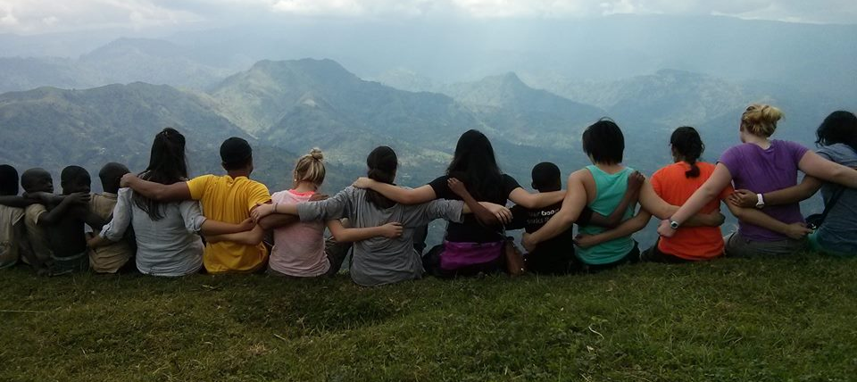
FIMRC Chaptership Program

Slide 2

Overview
Our chapters serve as the heart of the FIMRC organization. Through their work to spread awareness, fundraising, and local service they play a vital part in expanding and continuing the work of FIMRC.
Our chaptership program currently consists of 45 active chapters across the globe. The chaptership program is largely based out of the United States, but also extends to Australia, Pakistan, Canada, and Nigeria.

Slide 3
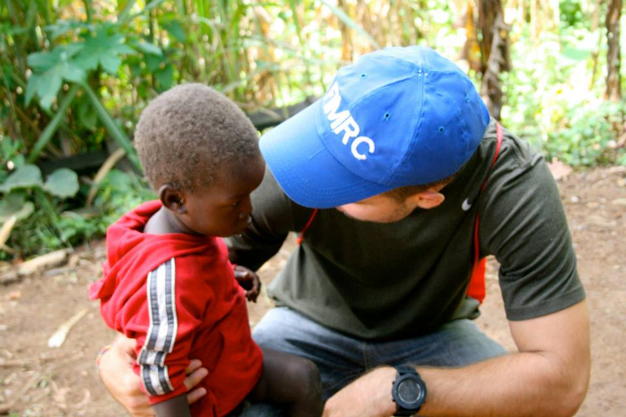
Chapter Responsibilities
Advocacy: Chapters are the voice of FIMRC within their communities and are vital in sharing our story and mission with the world.
Fundraising: Chapters provide a significant amount of money and resources that keep our project sites going. Through Adopt-a-Project programs as well as fundraising efforts they are able to alleviate the costs of our projects, and allow us to continue expanding.
Volunteering: Both locally and abroad, chapters provide volunteers who are passionate about making a difference
Professional & Personal Development: Fostering career and leadership skills, humbling experiences that will impact your perspective on life.

Slide 4
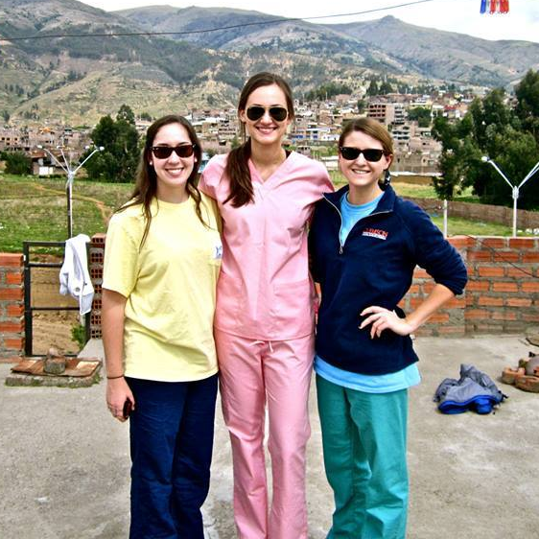
Recruiting
Hold interest meetings
Tabling at organization fairs and events
Post flyers
Make announcements in local blogs or news outlets
Utilize social media
Be persistent
Be personal

Slide 5
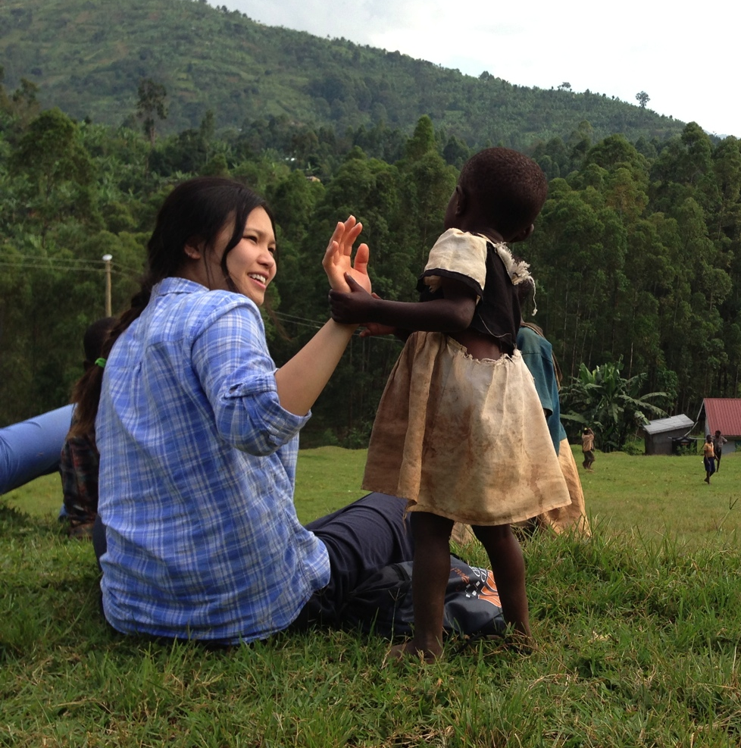
Holding Meetings
Share updates from project sites you are supporting
Discuss future events and improvements
Use incentives and recognize a hardworking member
Share updates
Use a PowerPoint to help you organize
Be prepared, and make meetings fun!

Slide 6

Volunteering Locally
Volunteering in your local community allows you to bond with your members while giving back. It is great for our chapters to reflect the work they do abroad back at home.
Volunteer at a local hospital
Cook for a soup kitchen or Ronald McDonald house
Tutor kids after school
Help out at a shelter

Slide 7

Fundraising
This is a way to continue giving back to project sites once you are back home.
Adopt-a-Projects allow you to fundraise for a specific project site needs and receive updates.
Gives back to FIMRC and allows us to expand our efforts.
Helps to raise awareness about our mission and purpose of providing access to medical care for underserved children around the world!

Slide 8
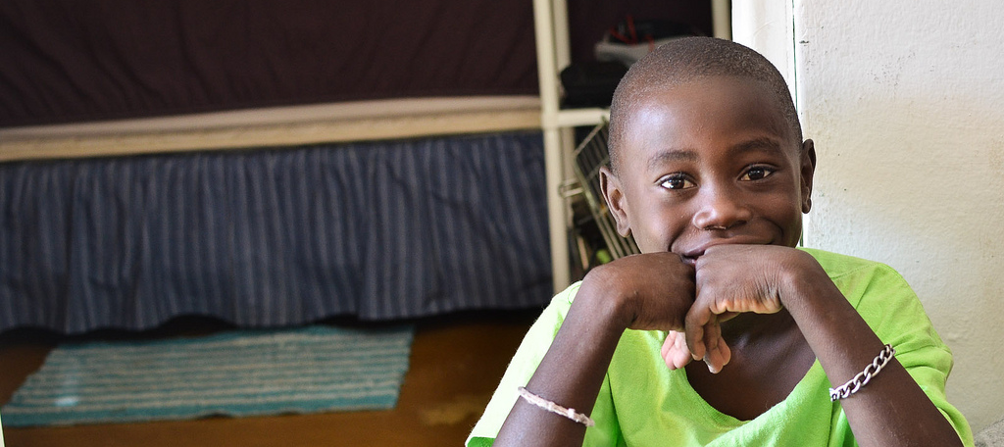
Thank You!
To continue making a difference or for additional information email us at chaptership@fimrc.org

